Slide 1


Uniq
College Info Reimagined

Slide 2


Problem

Slide 3
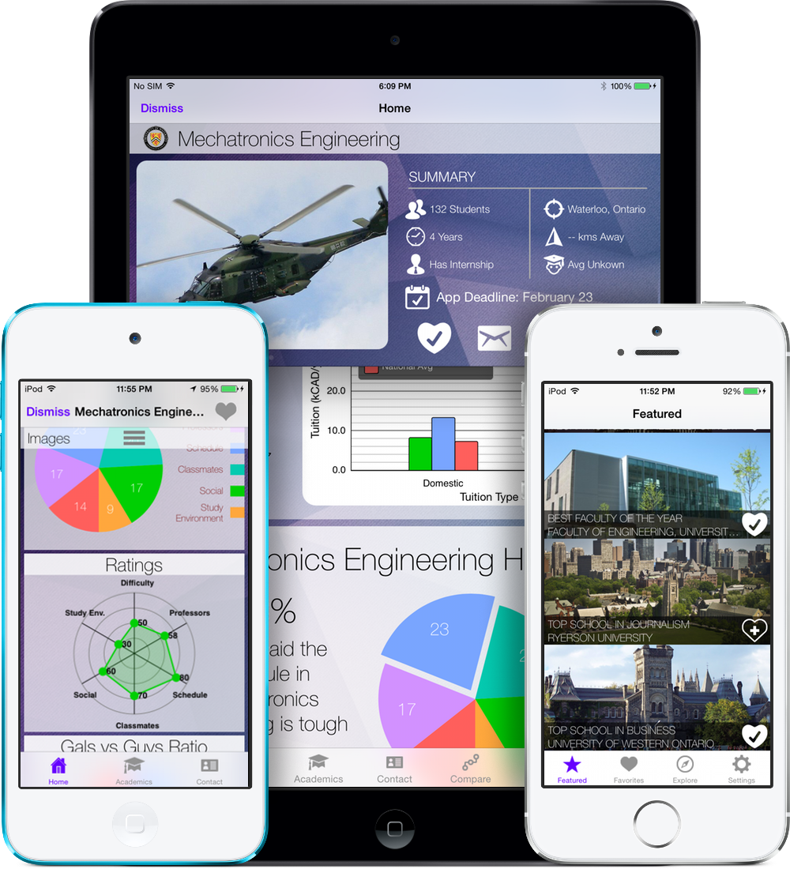

Uniq

Slide 4
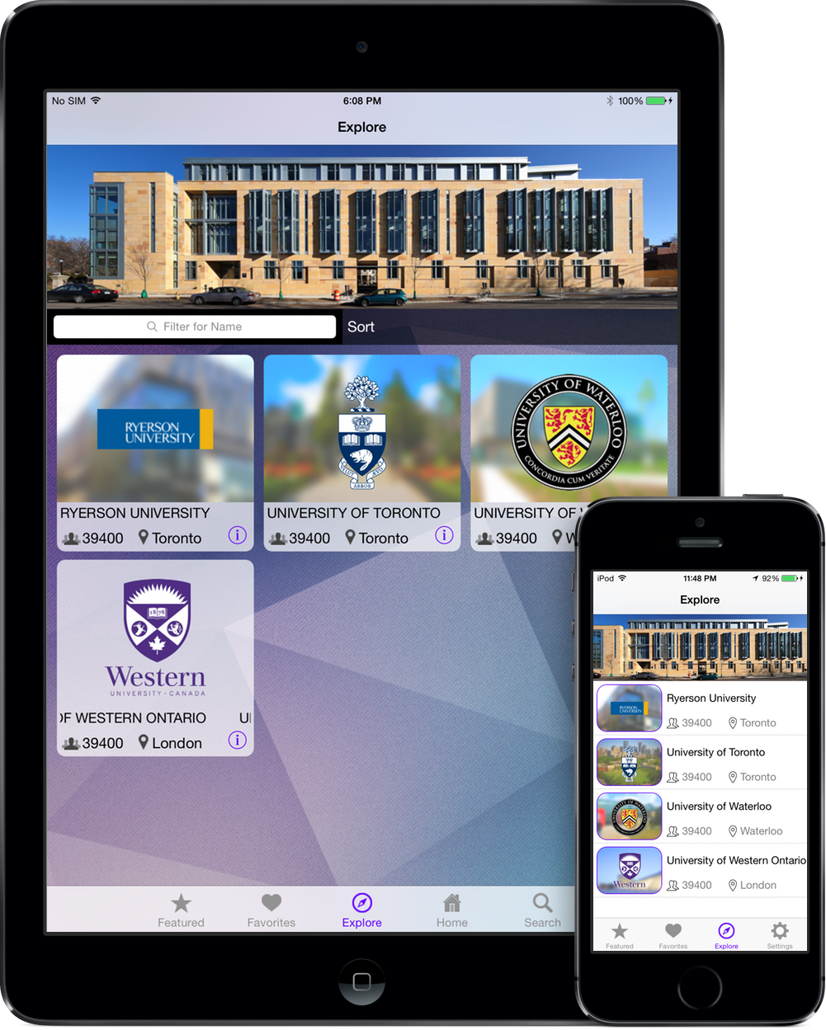
Uniq
Personal Assistant for Colleges
Smart
Personal
Lightning Fast

Slide 5


Smart Search
Voice Enabled
Natural Language
Instant Answers

Slide 6
"We believe technology is at its best, at its most empowering, when it simply disappears."
— Jonathan Ive, Senior Vice President, Design, Apple

Slide 7
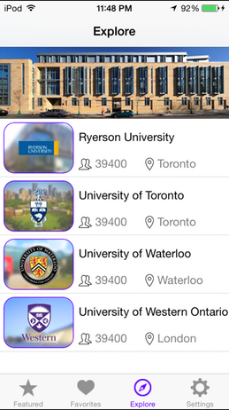
Explore
Minimalistic
Elegant
Intuitive

Slide 8
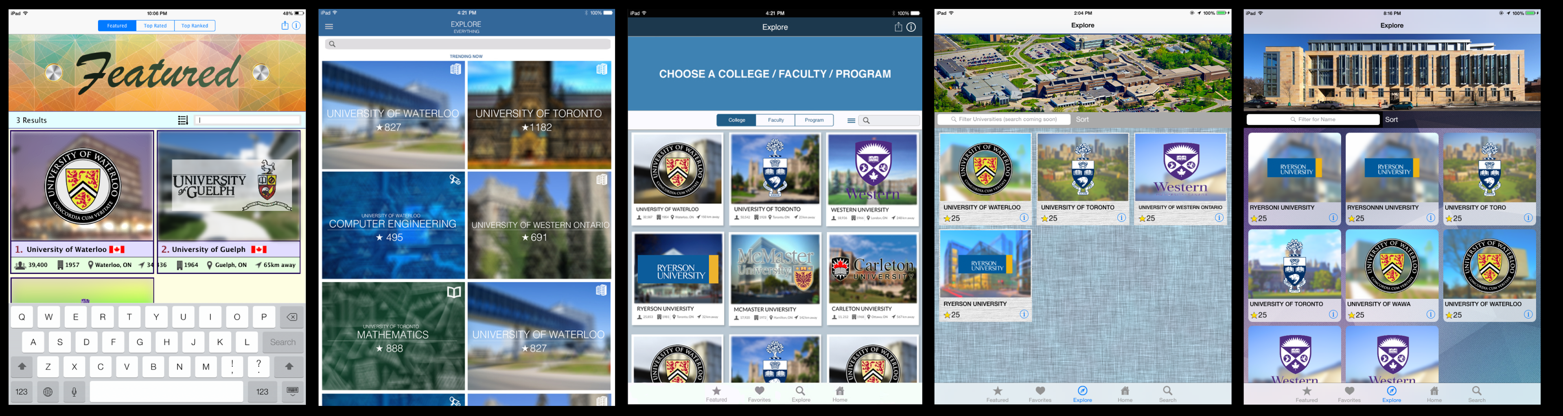
Design Iterations

Slide 9
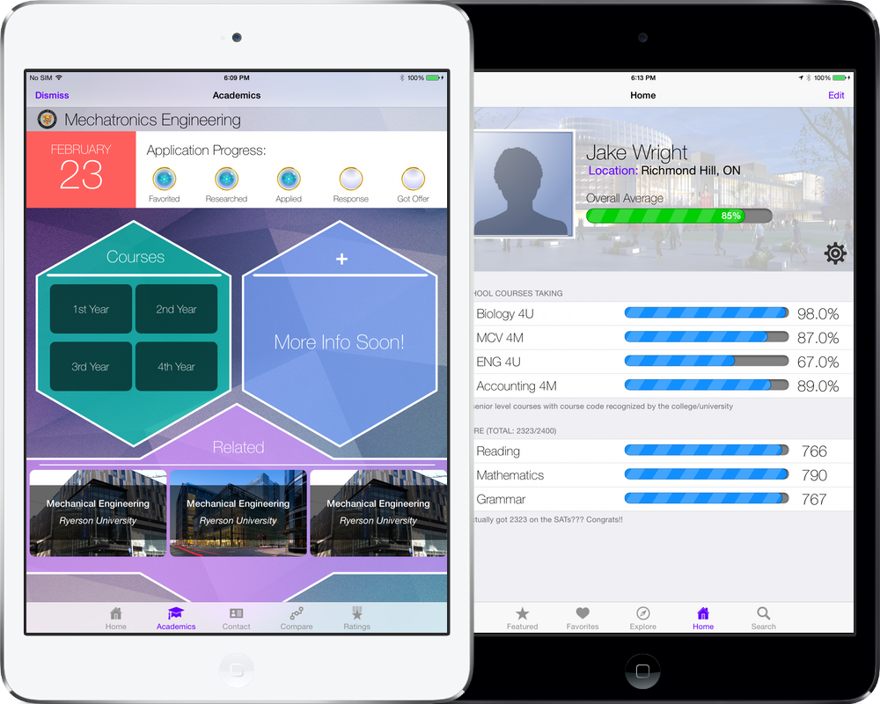
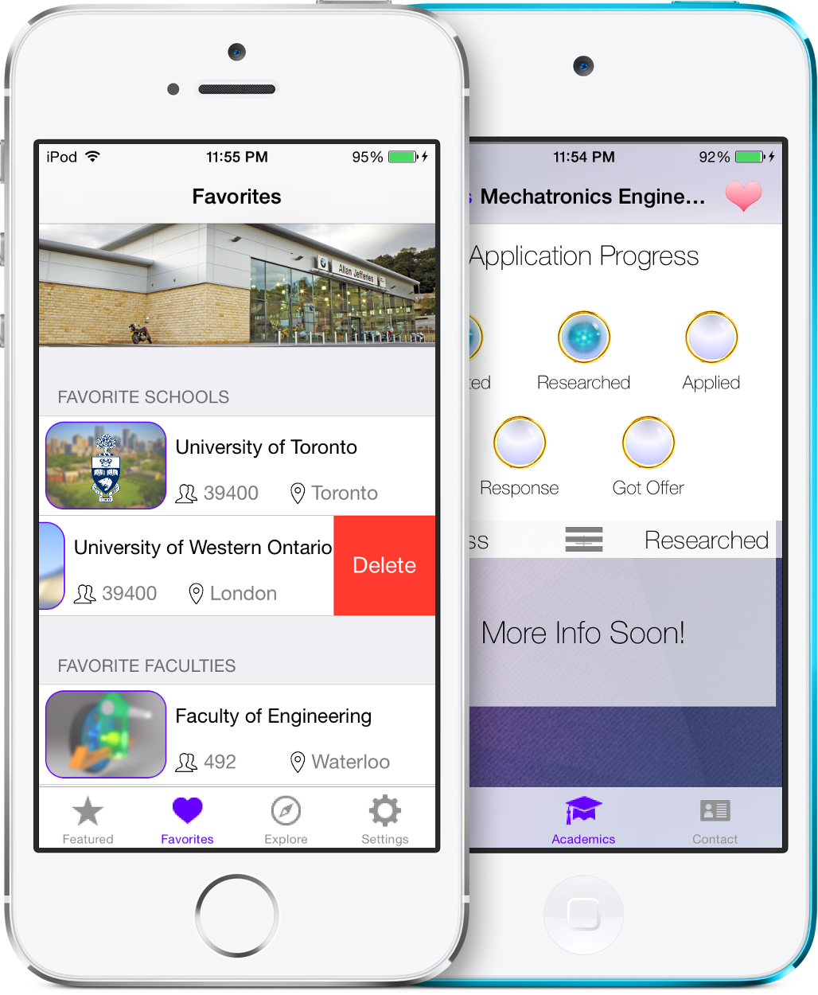
Powerful Features
Personal Suggestions
Push Notification
Offline access
Application Progress
Program Ratings
Program Comparison
More...

Slide 10
Survey
158 responses

Slide 11
$570,500,000
Advertising Spending (2013)
U.S. Universities

Slide 12
TEAM Uniq!
Jake Feng: 2B Mechatronics Engineering, UW
Christopher Luc: 2A Software Engineering, UW
Richard Lee: Graphics Design, George Brown
Andre Lee: 2B Mechatronics Engineering, UW
Aaron Te: 2B Computer Engineering, UW

Slide 13
Uniq
College Info Reimagined

Slide 14
Uniq
Website: uniq.url.ph
E-mail: technochimera@gmail.com
Twitter: @uniqios

